Slide 1
Automatic Watering System For Plants Deciding and Buying Components
Submitted by,
Induja Sudhish(c0769921)
Group 6

Slide 2
List of components needed for the project.
Beagle bone Black
Soil Moisture Sensor(FC-28)
Temperature and Humidity Sensor(DHT22)
Light Sensor(LDR)
Motor Driver(L293D)
DC motor(12V)
Resistors &Capacitors
Power Supply
WIFI Module(esp8266 Wi-Fi module)
Jumper wires
Soldering kit
Zero PCB

Slide 3
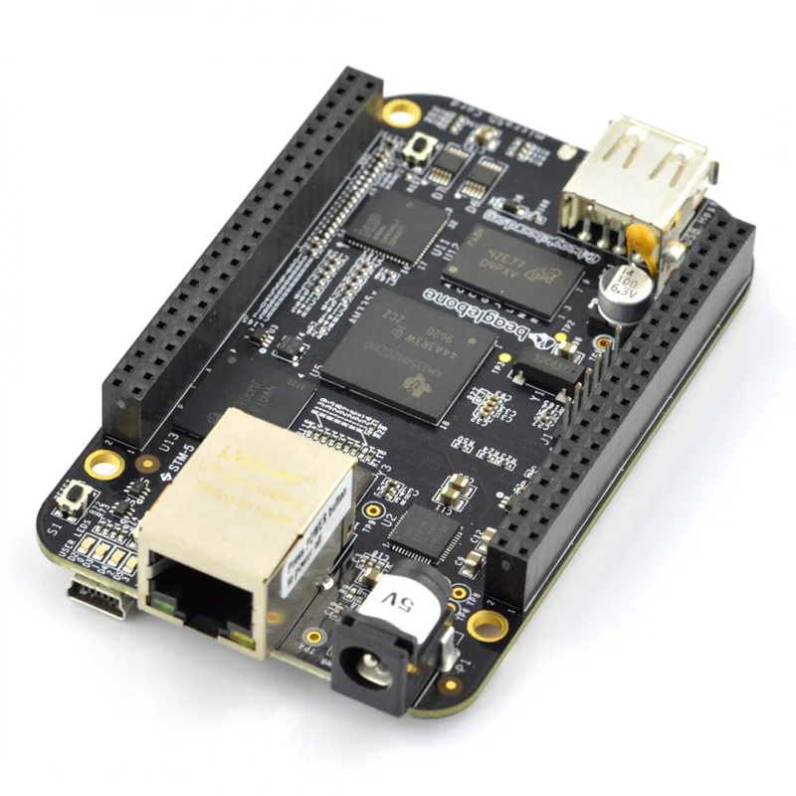
Beagle Bone Black
It is a powerful ARM technology based development
board which is widely adopted in embedded applications.
Here we are using Beaglebone Black REV C with
1 GHz processor and 512 MB onboard DDR3 RAM.
It comes with a mini-B cable for powering it up.
As the BBB has onboard flash storage no micro SD
Card is included and also no SD card loading is
Required to get started.

Slide 4
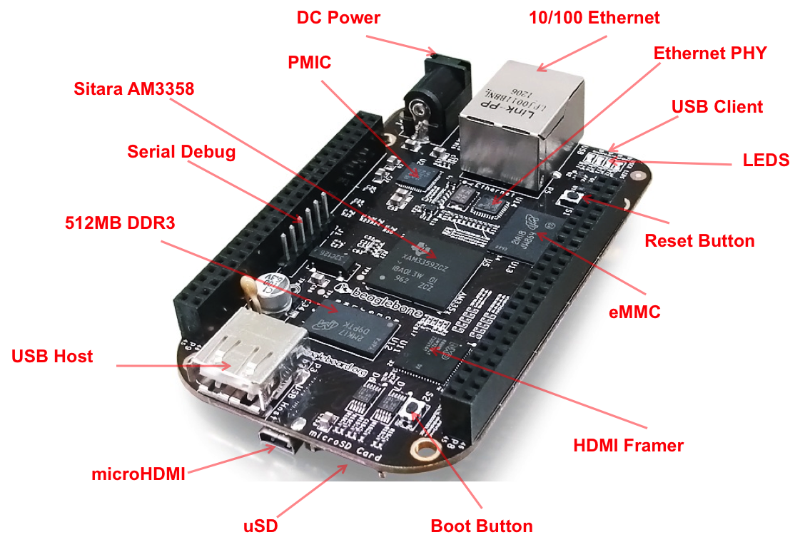
Advantages of Using Beagle bone black
Beagle bone is considered to be more efficient to read data's from our sensors and to give commands to the motors.
It has 65 input and output pins and a huge
number of supported interfaces which makes
it the best choice for our project.

Slide 5
Availability of the component
The beagle bone black Rev c is available in various websites like amazon, Newark, Elmwood electronics.
https://www.amazon.ca/Beagleboard-BBONE-BLACK-4G-BeagleBone-Rev-C/dp/B00K7EEX2U
Currently it is available in amazon for $142.02

Slide 6
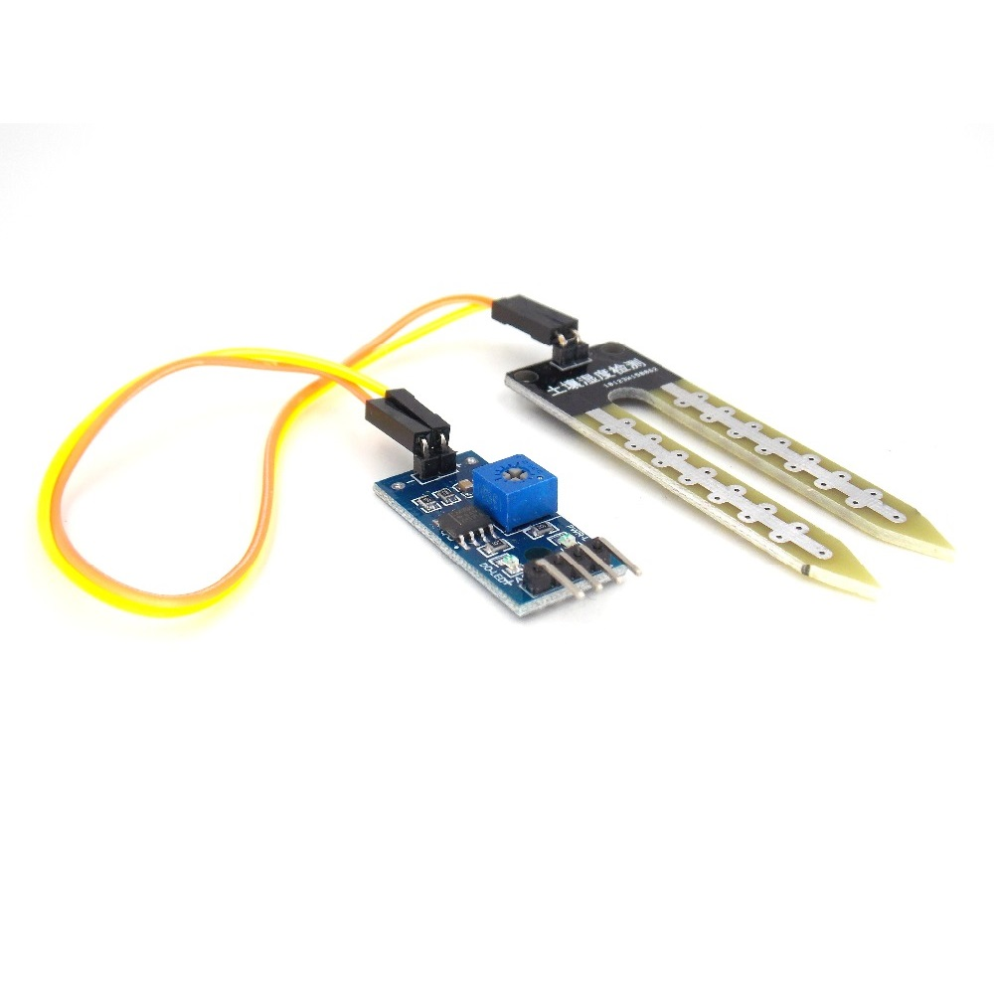
Soil moisture sensor(FC-28)
This is used to measure the moisture content of the soil by using the two probes which is attached to the sensor which act as a variable resistor.
This sensor will measure the
volumetric content of the water.

Slide 7
The more water in the soil means better the conductivity between the probes and result in a lower resistance and higher the AOUT.
The specifications of the FC-28 soil moisture sensor are as follows:
Input Voltage: 3.3–5V
Output Voltage: 0–4.2V
Input Current: 35mA
Output Signal: both analog and digital

Slide 8
Pin-out:
The FC-28 soil moisture sensor has four pins:
VCC: Power
A0: Analog Output
D0: Digital Output
GND: Ground

Slide 9
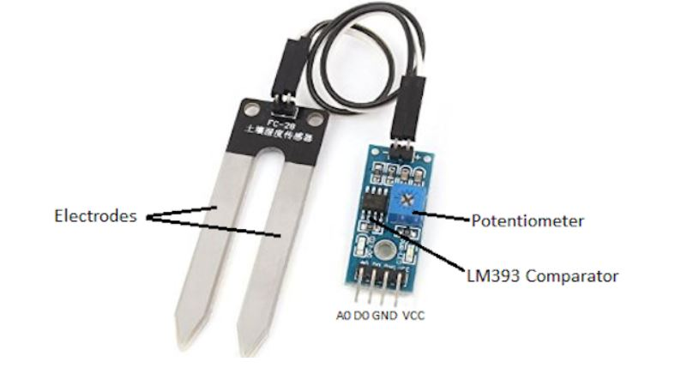
To connect the FC-28 in digital mode we will connect the digital output of the sensor to the digital GPIO pins of the beagle bone black.
There is a potentiometer in the sensor module, which
is used for setting the threshold value.
The threshold value is then compared using the LM393
comparator, which is mounted on the sensor module, with
the sensor output value.
The comparator LM393 measures the output value of
the sensor and the threshold value, and then provides us with the output
via the digital pin.

Slide 10
Advantages of FC-28 Soil moisture sensor
By using this sensor the irrigation system can be managed more efficiently and effectively.
This sensor uses one of the simple method for measuring the moisture content of the water.
And we can find out the result immediately.
This sensor can be used to connect in analog and digital modes.

Slide 11
Availability
This is available in https://www.amazon.ca/FC-28-D-Hygrometer-Detection-Module-Moisture/dp/B00XPJ8O7E
It is available in various other websites like aliexpress.com

Slide 12
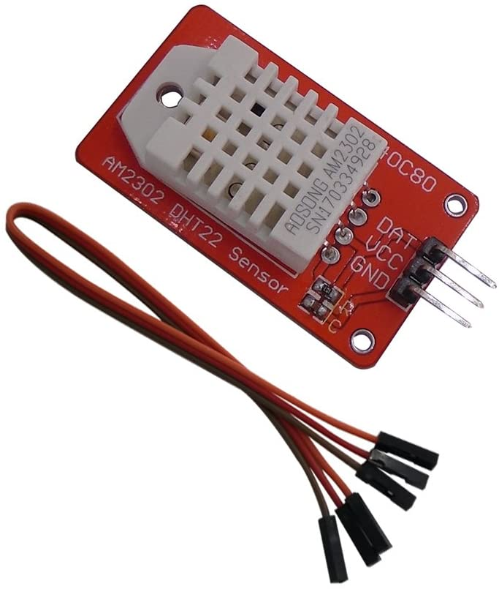
Temperature and Humidity sensor(DHT22)
This sensor is used to measure the surrounding air by using the capacitive humidity sensor and a thermistor and spits out a digital signal on the data pin.

Slide 13
Technical details
Low cost
3 to 5V power and I/O
2.5mA max current use during conversion (while requesting data)
Good for 0-100% humidity readings with 2-5% accuracy
Good for -40 to 80°C temperature readings ±0.5°C accuracy
No more than 0.5 Hz sampling rate (once every 2 seconds)
Body size 27mm x 59mm x 13.5mm (1.05" x 2.32" x 0.53")
4 pins, 0.1" spacing
Weight (just the DHT22): 2.4g

Slide 14
It comes in a case which has a humidity sensing component along with a NTC temperature sensor (or thermistor) on the sensing side.
The humidity sensing part is used to measure humidity, and is sandwiched between two electrodes with a moisture-holding substrate (usually a salt or conductive plastic polymer).
When water vapor is captured by it, the ions are emitted by the substrate, which in turn improves the conductivity between the electrodes.

Slide 15
The change in resistance is proportional to the relative humidity between the two electrodes.
The resistance between the electrodes is reduced by higher relative humidity, while lower relative humidity raises the resistance between the electrodes.
It consist of a NTC temperature sensor/Thermistor to measure temperature.
A thermistor is a thermal resistor-a resistor that with temperature changes its resistance.

Slide 16
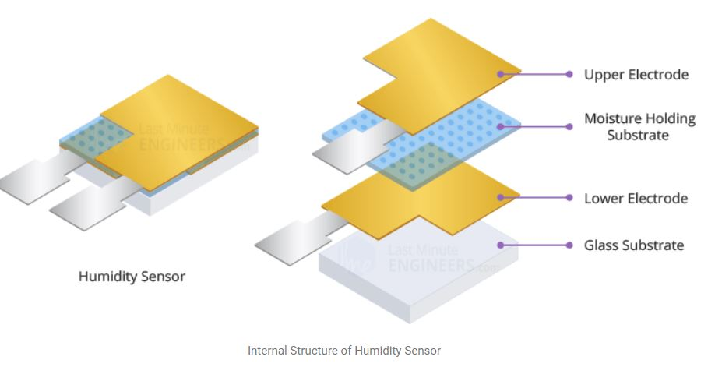
All resistors are theoretically thermistors, their resistance varies somewhat with temperature, but the change is typically very minor and difficult to measure.

Slide 17
Advantages of using DHT22 SENSOR
This is one of the most accurate sensors which is low in cost.
It is Good for -40 to 80°C temperature readings ±0.5°C accuracy.
the DHT22 sensor has better humidity measuring range, from 0 to 100% with 2-5% accuracy
Small size, low power consumption and long transmission distance are considered to be one of the important factors which makes it suitable for most of the harsh applications.

Slide 18
Availability
This sensor is available in Digi key, amazon, eBay, and various other websites.
https://www.amazon.ca/DSD-Temperature-Humidity-Arduino-Raspberry/dp/B07CM2VLBK/ref=asc_df_B07CM2VLBK/?tag=googleshopc0c-20&linkCode=df0&hvadid=293016807031&hvpos=&hvnetw=g&hvrand=4573677808363799697&hvpone=&hvptwo=&hvqmt=&hvdev=c&hvdvcmdl=&hvlocint=&hvlocphy=9000894&hvtargid=pla-465391317976&psc=1
It is available in amazon for $14.99

Slide 19
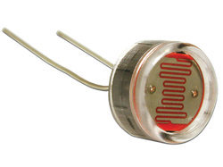
Light sensor(LDR)
Light dependent resistors, LDRs, or photoresistors are electronic components that are used to detect light & change the operation of a circuit dependent upon the light levels.
The light dependent resistors(LDR)are used to detect the presence of level of light in the model.
They provide large change in resistance for changes
in light level.

Slide 20
Advantages of using LDR sensors
High sensitivity (due to the large area it can cover).
Easy employment.
Low cost.
There is no union potential.
High light-dark resistance ratio.

Slide 21
Availability
It is available online in various websites for different prices mostly around $2
https://www.robotshop.com/ca/en/mini-photocell-light-sensor.html?gclid=Cj0KCQiA962BBhCzARIsAIpWEL2DtgGV9yi9HhNMudu76prDjmgJlbcRUNOq9VWl2gqb1XqUw2-aROgaAviwEALw_wcB

Slide 22
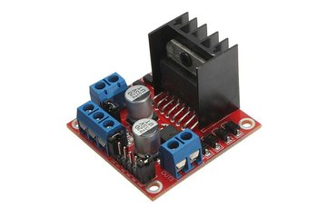
Motor driver (L298N)
L298N chip can directly drive two 3-30V DC motor, here we are using a 12V DC motor.
The circuit will allow you to easily and independently control two motors of up to 2A each in both directions.
It is ideal for robotic applications and well suited
for connection to a microcontroller requiring just
a couple of control lines per motor

Slide 23
Advantages of L298N
The beagle bone has an output voltage of 5V ,but the motor we are using require 12V to operate.
So to supply this high voltage to the Motor we ca use this motor driver in between the beagle bone and the Motor.
Beagle Bone
Motor Driver
Motor

Slide 24
Availability
It is available as a module in amazon.ca for $9.99
https://www.amazon.ca/PChero-Controller-Module-Stepper-Arduino/dp/B07GTCWN9Z/ref=asc_df_B07GTCWN9Z/?tag=googleshopc0c-20&linkCode=df0&hvadid=459480626555&hvpos=&hvnetw=g&hvrand=11366580824085057770&hvpone=&hvptwo=&hvqmt=&hvdev=c&hvdvcmdl=&hvlocint=&hvlocphy=9000894&hvtargid=pla-652109211542&psc=1

Slide 25
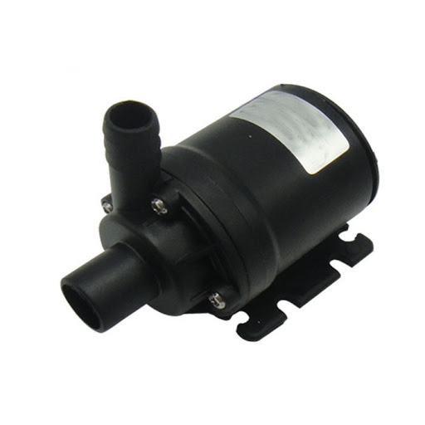
Water Pump
The motor is used in this project to pump water to the plants by receiving the command from the beagle bone black.
The beagle bone will sense the information from the sensors
and send the command to run the motor
accordingly.
In this project we are using a 12V water
pump for the plants.

Slide 26
Availability
This available in amazon.ca for CAD 14.89
https://www.amazon.ca/LEDGLE-Submersible-Ultra-Quiet-Dual-Purpose-Hydroponics/dp/B07G74MDLM/ref=asc_df_B07G74MDLM/?tag=googleshopc0c-20&linkCode=df0&hvadid=335210432629&hvpos=&hvnetw=g&hvrand=11974487029324101271&hvpone=&hvptwo=&hvqmt=&hvdev=c&hvdvcmdl=&hvlocint=&hvlocphy=9000894&hvtargid=pla-738142332843&psc=1

Slide 27
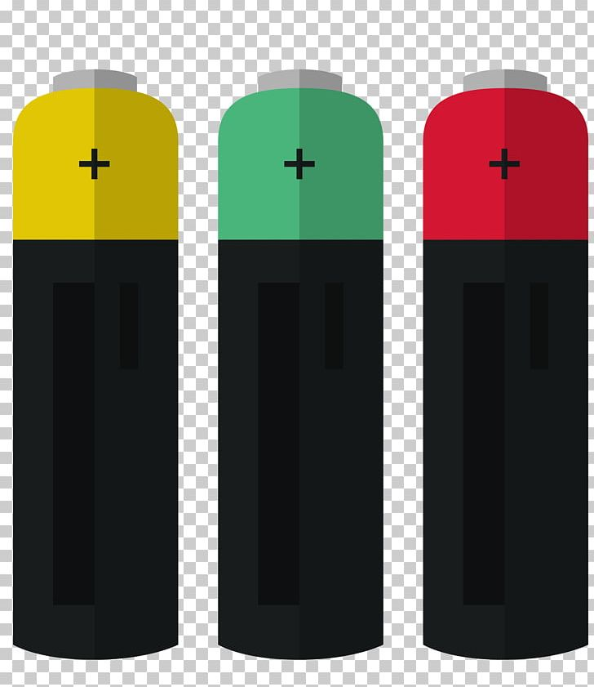
Power Supply
Here we are using a 5V battery to provide power to the beagle bone black and a 9 V battery to provide power to the motor driver which runs the motor.

Slide 28

WIFI module(ESP8266)
The ESP8266 Wi-Fi Module is a self contained SOC with integrated TCP/IP protocol stack that can give any microcontroller access to your Wi-Fi network.

Slide 29
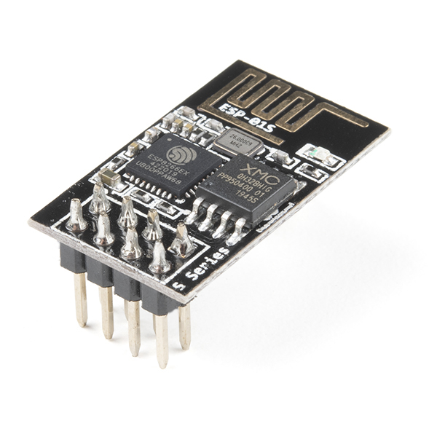
It is capable of either hosting an application or offloading all Wi-Fi networking functions from another application processor.

Slide 30
This module has a efficient on-board processing and storage capability that enables it to be implemented into its GPIOs with minimal up-front development and minimal loading during runtime with the sensors and other application specific equipment.
Every ESP8266 module comes pre-programmed with a firmware set of AT commands, which means you can simply connect it to your beagle bone and get as much Wi-Fi capability as a Wi-Fi Shield provides.

Slide 31
Availabilty
This available in Robot shop for CAD 6.53
https://www.robotshop.com/ca/en/elecrow-esp8266-wifi-module.html?gclid=Cj0KCQiA962BBhCzARIsAIpWEL0f-RXu3_rVUEPGIWobq9knoA4JpCJgN7jWAkjsYFYscz9uMzf07KUaAiAnEALw_wcB

Slide 32
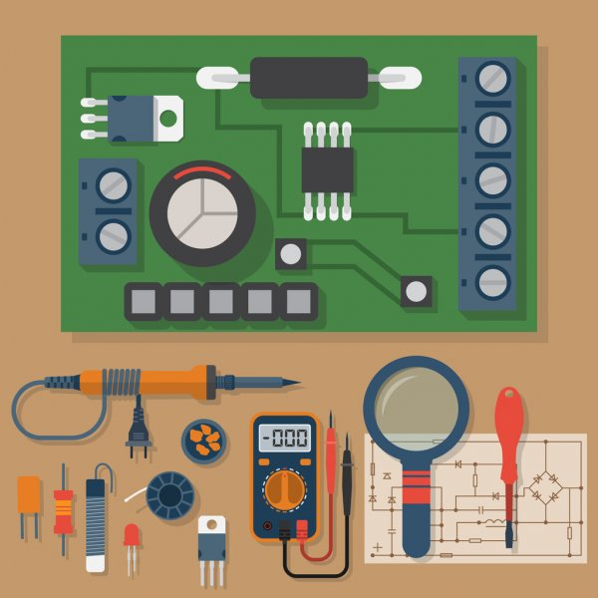
Soldering kit
It consist or various equipment's like soldering iron, wire cutter, soldering stand, safety glasses, Soldering tools for desoldering etc.

Slide 33
This is avaible in amazon .ca for CAD 28.68
https://www.amazon.ca/Soldering-Electronics-Welding-Switch-Tweezers/dp/B0882VM47R/ref=asc_df_B0882VM47R/?tag=googleshopc0c-20&linkCode=df0&hvadid=335241488547&hvpos=&hvnetw=g&hvrand=2657608807680005074&hvpone=&hvptwo=&hvqmt=&hvdev=c&hvdvcmdl=&hvlocint=&hvlocphy=9000894&hvtargid=pla-923818815789&psc=1

Slide 34
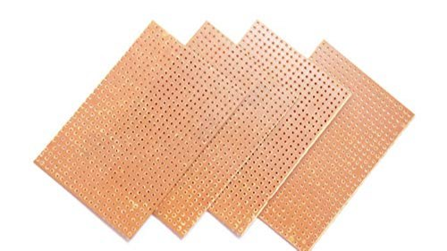
Zero PCB
Zero PCB is basically a general-purpose printed circuit board (PCB), also known as perfboard or DOT PCB
It is a thin rigid copper layer with holes pre-drilled around a grid with 2.54mm (0.1-inch) spacing between holes at standard intervals.

Slide 35
Availability
This is available in Elmwood electronics for CAD 7.99
https://elmwoodelectronics.ca/products/bakelite-universal-perfboard-plates-pack-of-10?variant=24126910531&currency=CAD&gclid=Cj0KCQiA962BBhCzARIsAIpWEL2vdOGpGtEHZWVhSFJuHkyfWG9PshE1r2g0WgMu-ZtveZOjWf1Hh7IaAlZHEALw_wcB

Slide 36
Resistors and jumper wires
Jumper wires are available in amazon.ca for CAD 12.99
https://www.amazon.ca/IZOKEE-240pcs-Solderless-Breadboard-Arduino/dp/B08151TQHG/ref=asc_df_B08151TQHG/?tag=googleshopc0c-20&linkCode=df0&hvadid=335380394635&hvpos=&hvnetw=g&hvrand=12071104075935955786&hvpone=&hvptwo=&hvqmt=&hvdev=c&hvdvcmdl=&hvlocint=&hvlocphy=9000894&hvtargid=pla-871319839190&psc=1
Resistors are available in Digi key for CAD 0.43
https://www.digikey.ca/en/products/detail/yageo/FMP200JR-52-10K/2058963?utm_adgroup=Yageo&utm_source=google&utm_medium=cpc&utm_campaign=Smart%20Shopping_Supplier_Yageo&utm_term=&productid=2058963&gclid=Cj0KCQiA962BBhCzARIsAIpWEL126E7Mhta5KGQd5idghnIo_f0j18u_7lNATk_aOZRP2migYniKKzEaAlV9EALw_wcB

Slide 37
References
https://beagleboard.org/black
https://lastminuteengineers.com/dht11-dht22-arduino-tutorial/
https://www.electronics-notes.com/articles/electronic_components/resistors/light-dependent-resistor-ldr.php
https://www.electronicsforu.com/technology-trends/learn-electronics/veroboard-zero-pcb-difference
https://maker.pro/arduino/projects/arduino-soil-moisture-sensor
https://www.sparkfun.com/products/17146
https://components101.com/articles/what-is-motor-driver-h-bridge-topology-and-direction-control

